Slide 1
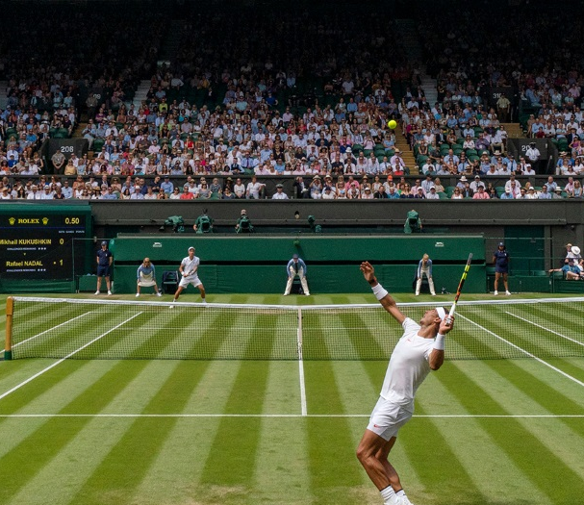
Tennis Dataset Analysis
Research Question: Which Statistical Features Are The Most Significant In Determining Tennis Match Outcomes?

Slide 2
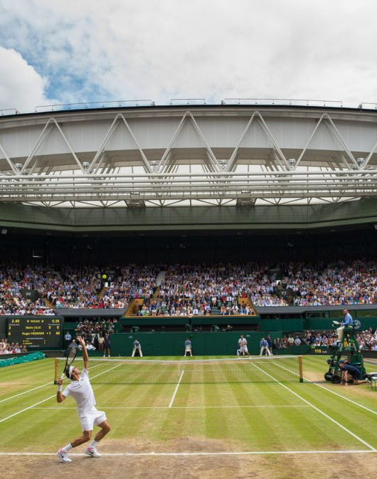
Motivation, Background and Other Academic Work In This Area
I have loved playing tennis for many years, now culminating in representing University of Kent.
I have previously been interested in tennis data analysis and carried out a short classification task on 2021-2024 ATP matches. Now I plan to research in more detail on 2016-2019 matches and find out whether the most significant predictors in determining the winner and loser are similar.
In terms of directly using the same Kaggle data, there are a couple of notebooks regarding tennis data analysis: Huge Tennis Database
There is a very popular YouTube channel, “Green Code”, that has made a video using complex models to predict match outcomes: I Trained AI to Predict Sports - YouTube

Slide 3
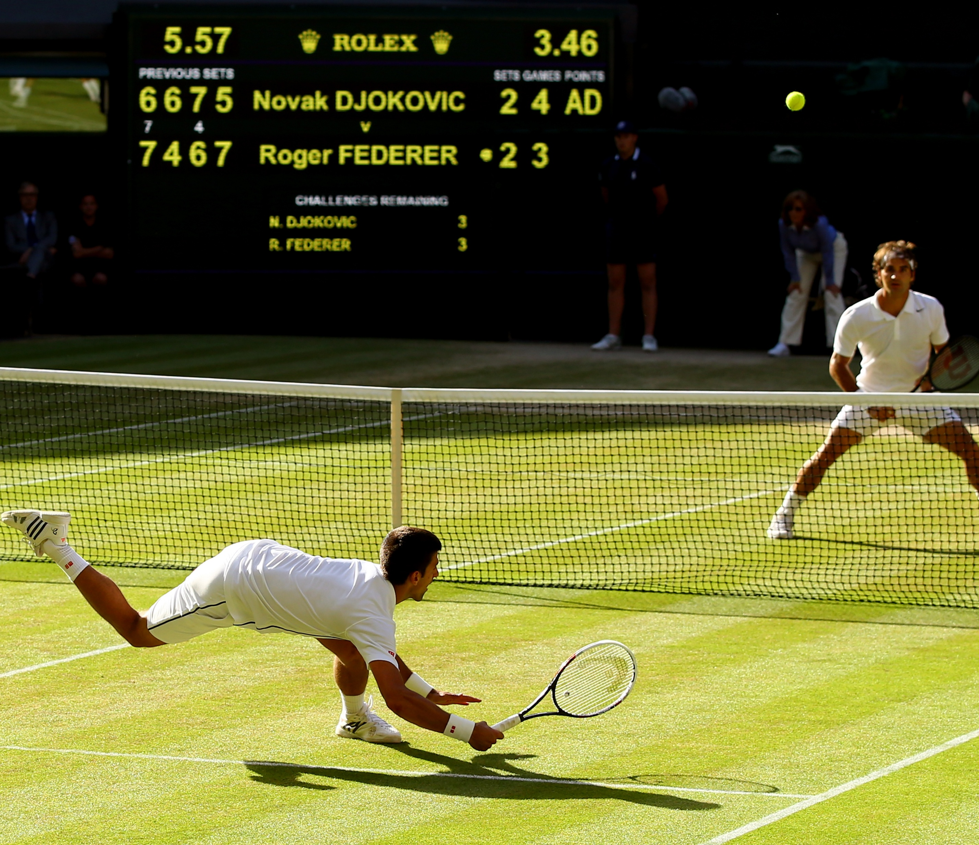
Data Overview
The data was accessed through Kaggle. In order to analyse four separate years of matches holistically, I read each dataset into my coding environment and used ‘bind_rows’ to combine them.
The raw data contains 49 columns. These include a range of pre-match facts, such as each player’s height and ranking, and post-match statistics, such as number of break points faced and saved. For a comprehensive explanations of the columns, please see: https://github.com/JeffSackmann/tennis_atp/blob/master/matches_data_dictionary.txt
In terms of data quality, I found out there were a number of NA values so removed most rows including any. Some columns did not have a legible name or values, so renamed those, including date.
Before classification, I restructured the dataset to include a distinctive win/loss response for each match.

Slide 4
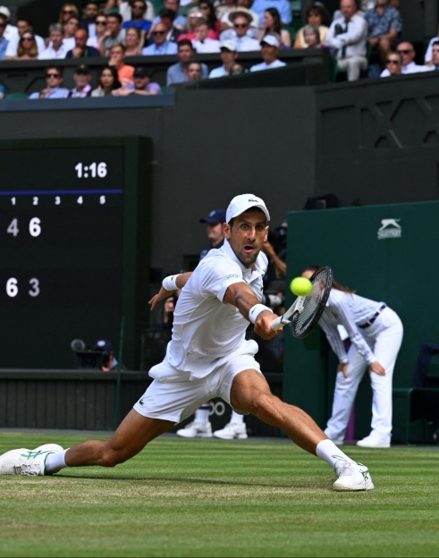
Methodology Overview
Fit a general linear model – simple logistic regression. I have used 5-fold cross validation in the training process and confirmed the model’s appropriateness with a half-normal plot of residuals. In addition to standard performance metrics, odds ratios can be derived and used to determine the most important features in winning/losing a match.
Do feature selection with a lasso logistic regression model and a then fit a ridge regularised logistic regression model. These models are less interpretable, but it is worth checking if performance can be improved.
Fit a random forest model with cross validation on the number of randomly sampled predictors at each split. This is also a very interpretable model.
Fit a neural network with cross validation on number of neurons and decay strength. How accurate can it be compared to our simpler models?

Slide 5
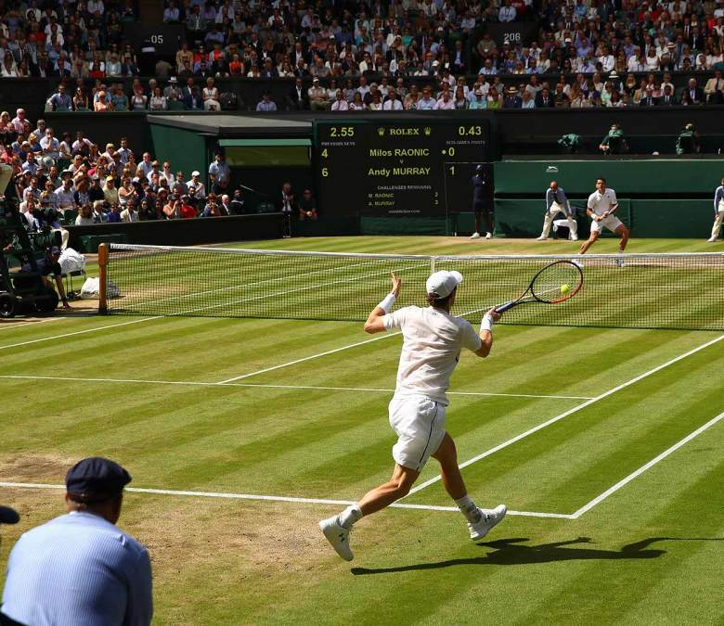
Comparing Models with Classical Classification Alternatives
My first model is the classical logistic regression, then followed by the alternative variants: lasso and ridge regularised. The main differences to the original are the penalty term (lasso reduces coefficients to zero while ridge just shrinks them). I have also selected the strength of lambda through cross validation, which determines the strength of the penalty.
My random forest model differs from the classical decision tree model by way of ensemble learning: the final decision on how to classify an entry is by the majority vote of all the trees. Random forest also uses bagging – not trained on the entire dataset, so robustness is improved. This is also enhanced by only selecting from a random subset of predictors at each split.
My neural network has been simplified compared to a standard deep one as results from earlier models suggested the additional complexity was not helpful for this dataset. E.g. there is only one hidden layer and the number of units per layer is quite small.

